Slide 1
Data analytics Project on Rock buster Stealth by Meenakshi.P.S.

Slide 2
Project Overview
In the bustling world of movie rentals, Rock buster Stealth LLC, a hypothetical global enterprise with physical stores scattered across the globe, is on the brink of a monumental shift. As it prepares to launch its online video rental platform, it finds itself in a fierce battle against industry giants—the titans of streaming services.

Slide 3
Key Questions from Stakeholders
Most of the Rock buster customers come from?
Movies yielding highest Revenue to Rock buster?
Movies yielding least Revenue to Rock buster?
Countries with highest sales?
Cities with most Customers all-over?
Average rental duration of Rock buster movies?

Slide 4
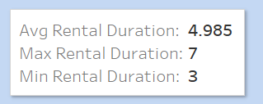
Average rental duration of Rock buster movies? Across the globe, the minimum duration of movie rented by customers was 3 days and the maximum is 7 days. On an average it is 5 days for a single movie.

Slide 5
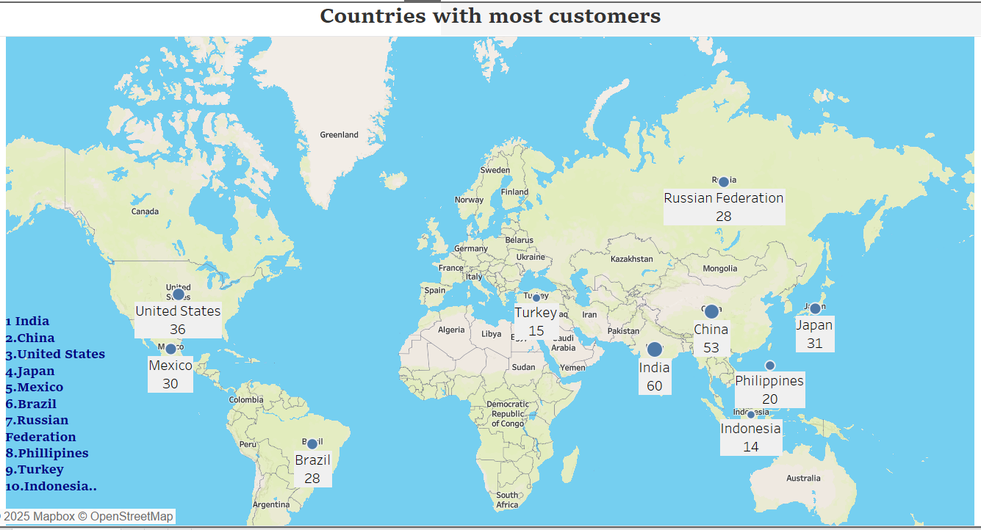
Most of Rock buster customers come from?
With India and China and top followed by other countries, Asia stands on top. The list of countries are listed in the map.

Slide 6
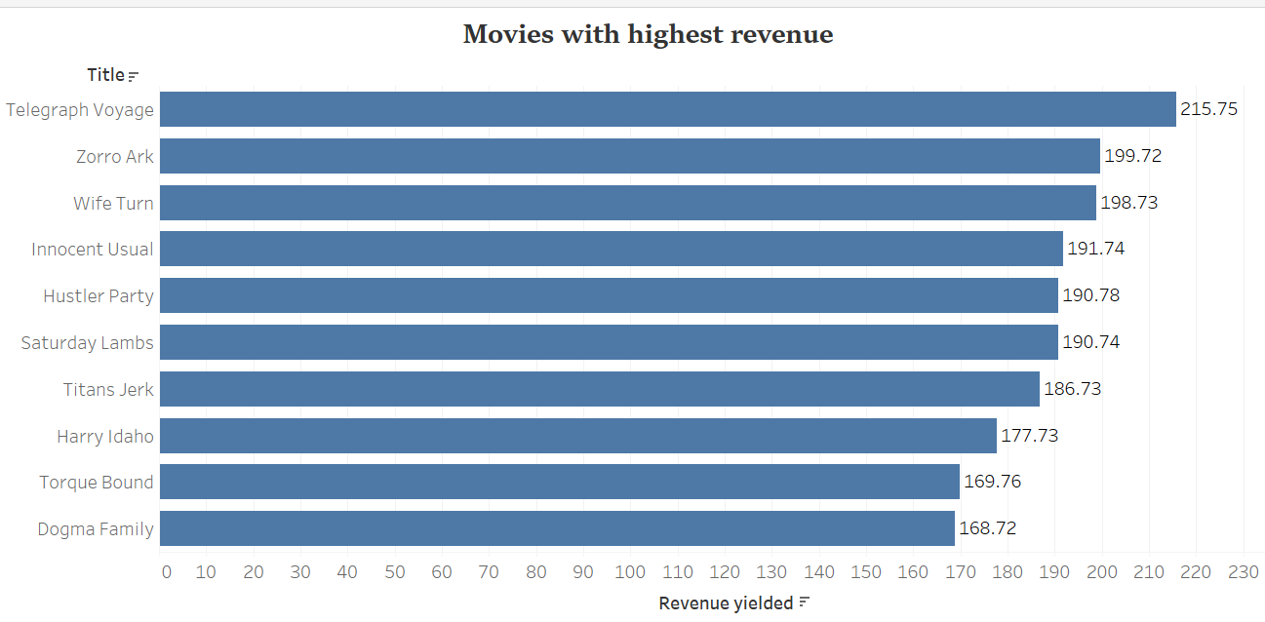
Movies yielding highest Revenue to Rock buster? The chart shows the movies yielding the most revenue for Rock buster. The amount displayed is in Euros.

Slide 7
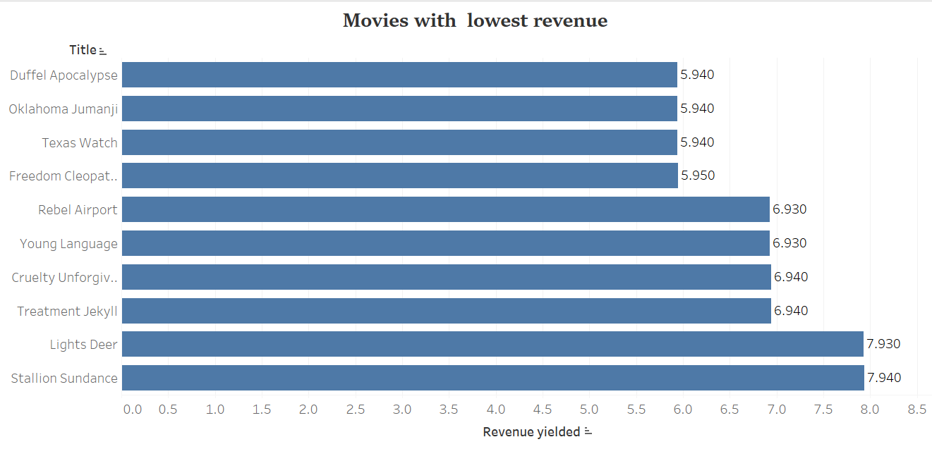
Movies yielding liest Revenue to Rock buster The chart shows the movies yielding the least revenue for Rock buster. The amount displayed is in Euros.

Slide 8
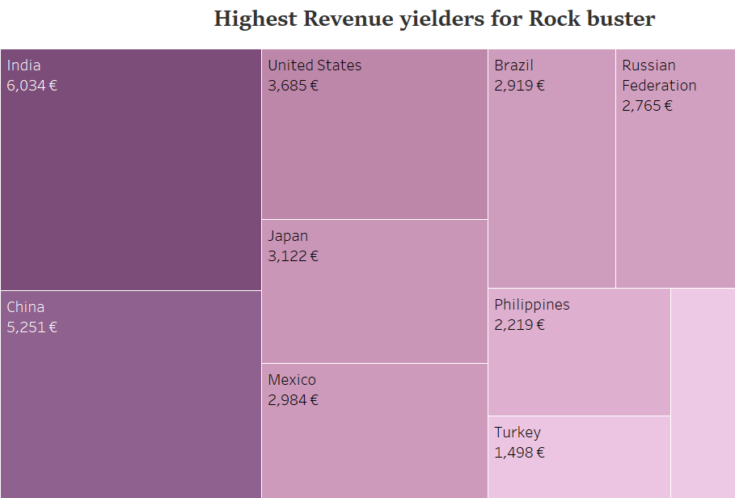
Topmost Countries with highest revenue The Sales turnover for Rock buster overall is displayed in the chart. The amount is in Euros.

Slide 9
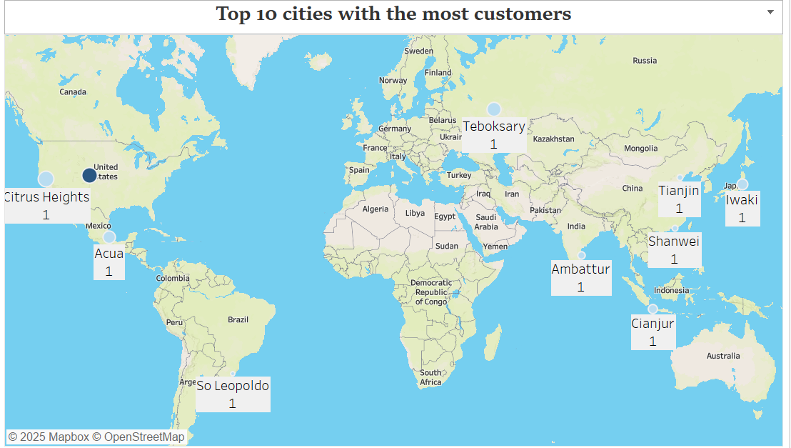
Cities with the most Customers for Rock buster The details of the City in which the customers of Rock buster reside in are highlighted in the map for the stakeholders to focus more thereby increasing the sales.

Slide 10

KEY FINDINGs AND SUGGESTIONS
Key Findings
Recommendations
Asia provides the highest revenue.
Average Rental duration is only 5 days
High revenue yielding movies are listed and displayed.
Asian language movies can be incorporated more.
Average Rental duration can be made for online movies for 3-4 days minimum.
Genre of those movies to be focussed more and more number of movies to be released.

Slide 11

Questions???

